Slide 1
Semester Break 3-4
24/6/24 - 7/7/24

Slide 2
Modify Measurement.py file
Add function that read all png and depth file in the folder and generate to result image in order.
The function is working well using cpu but when I update the mmdet version, it have error.
So I downgrade the version.
The current version that I used is
torch 1.8.2+cpu
torchaudio 0.8.2
torchvision 0.9.2+cpu
mmcv-full 1.6.0
mmdet 2.25.1

Slide 3
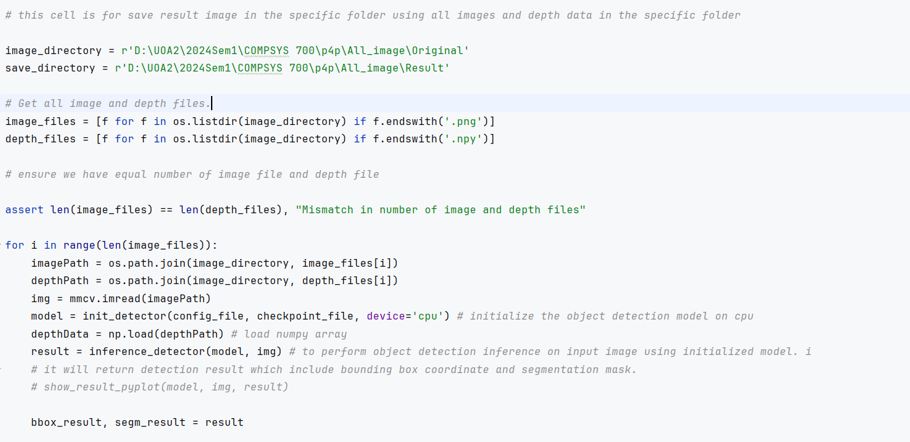
Code(1)

Slide 4
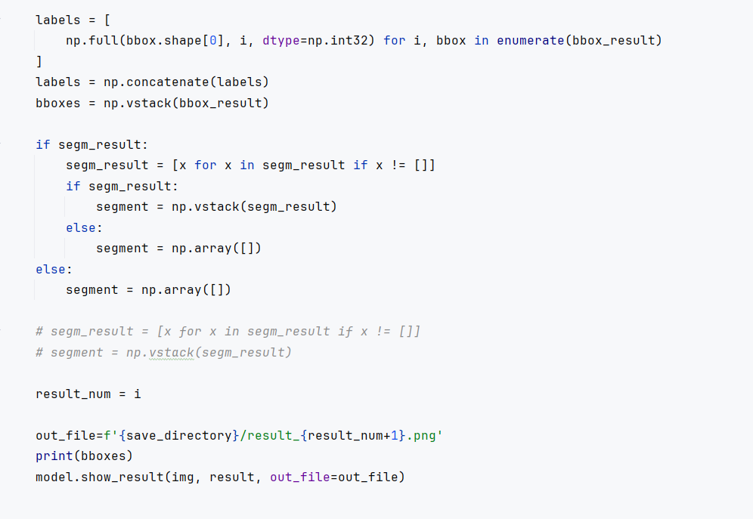
Code(2)

Slide 5
Change function using GPU CUDA
Use CUDA need to change torch version as 1.8.2 + CUDA 111

Slide 6
Feedback
For visualization purposes, colour of generated image need to change.
Currently, green labeled tomatoes are red colour and ripened and half-ripened tomatoes are green colour.
We need to change green labeled one to green color, and ripened labeled one to red colour.

Slide 7
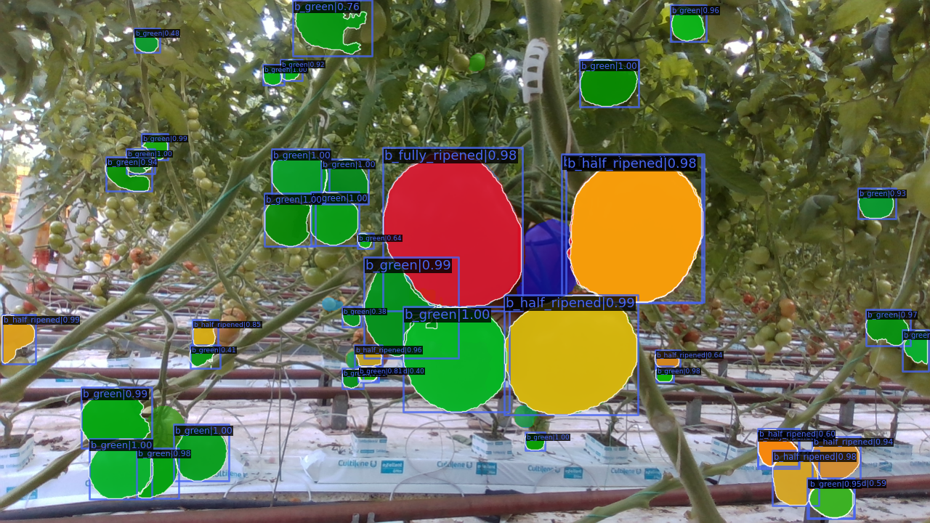
Change result colour

Slide 8
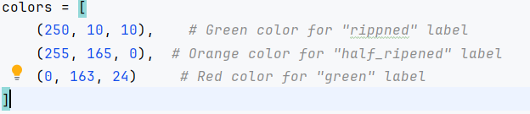
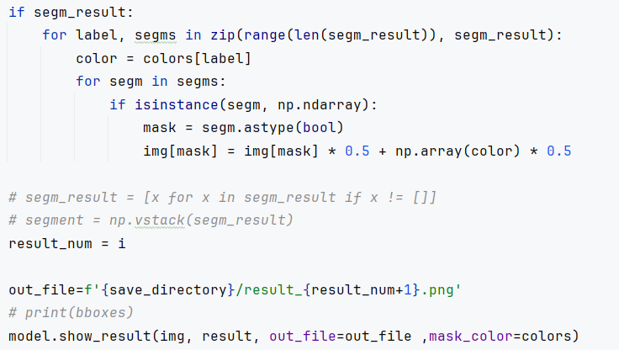
Colour change - add this code

